Slide 1

IOT SECURITY
1

Slide 2


# WHAT IS IOT ?
The Internet of Things (IoT) is a network of physical devices that can transfer data to one another without human intervention.
The term was first coined by computer scientist Kevin Ashton in 1999.
A Good Example of Iot is Your Smart Home Devices
2

Slide 3
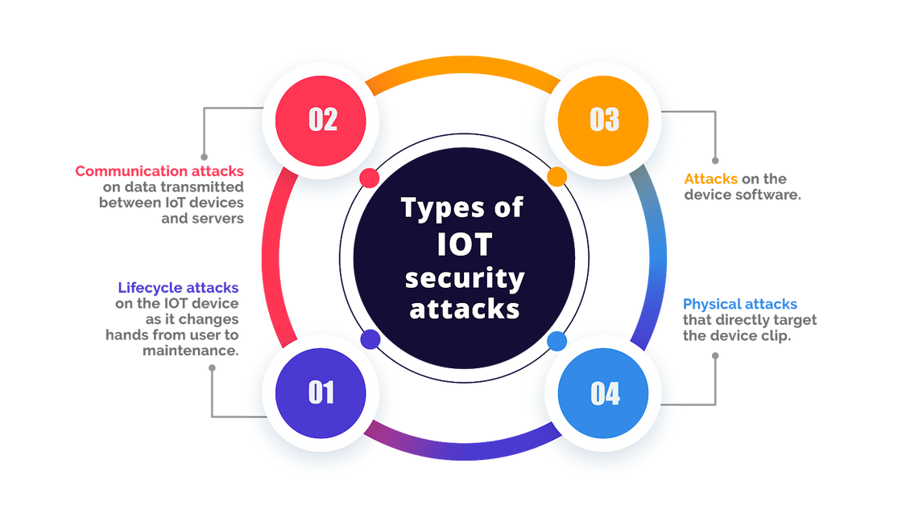
# WHAT IS IOT SECURITY ?
IoT security is based on a cybersecurity strategy to protect IoT devices and the vulnerable networks they connect to from cyber attacks.
IoT devices have no built-in security.
In next Slides we will discuss IoT compromise in different Ecosystems
Types of Iot Security Attacks
3

Slide 4
IOT USED IN DIFFERENT SECTORS AND THEIR SECURITY
ASPECTS
4

Slide 5
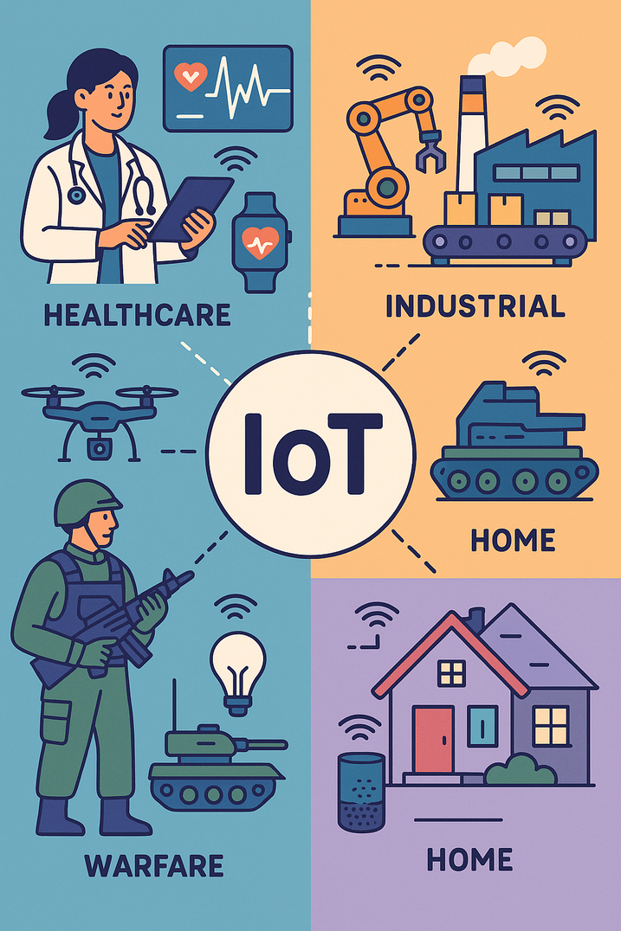
# IOT USED IN VARIOUS SECTORS
The Internet of Things (IoT) is used in homes for smart devices that enhance convenience and energy efficiency
In industries for automation and monitoring equipment
In healthcare for remote patient monitoring and medical devices
In warfare for advanced surveillance and communication systems.
5

Slide 6
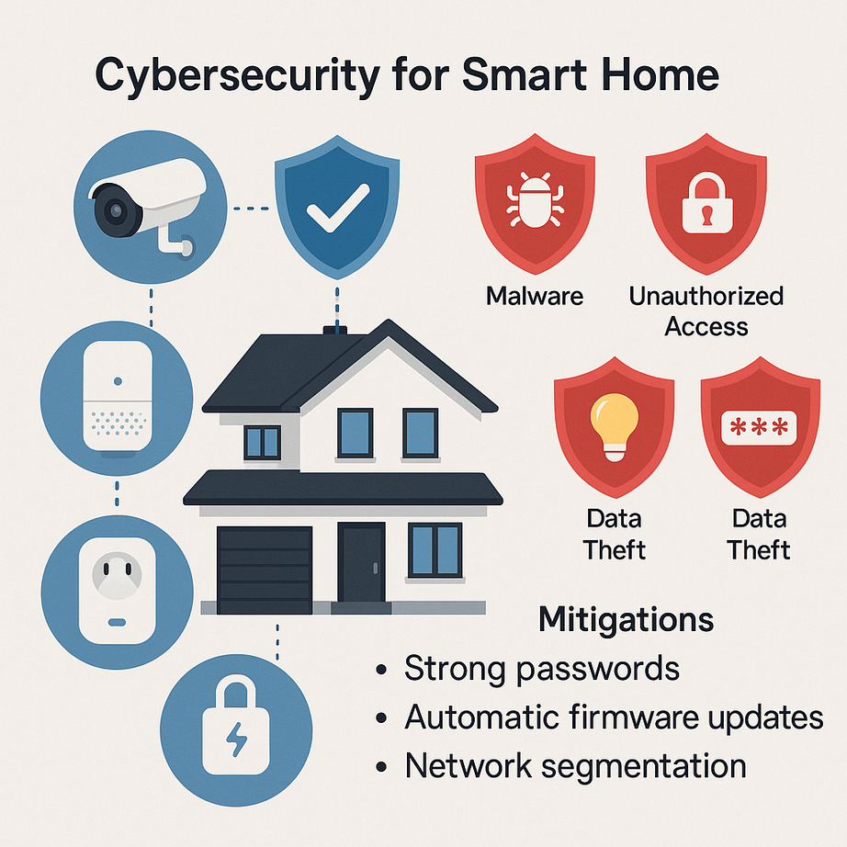
# IOT USED IN HOME
Scenario
A smart home ecosystem includes IoT-enabled thermostats, smart lights, smart locks, voice assistants (e.g., Alexa), and CCTV systems that communicate over Wi-Fi and are managed via a mobile app.
6

Slide 7
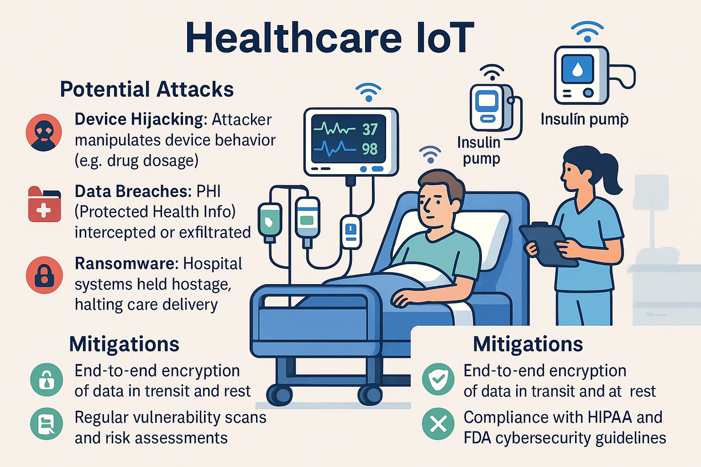
# IOT USED IN HEALTHCARE
Scenario:
Hospitals use IoT for patient monitoring (heart rate, oxygen levels), insulin pumps, connected imaging machines, and smart infusion pumps.
7

Slide 8
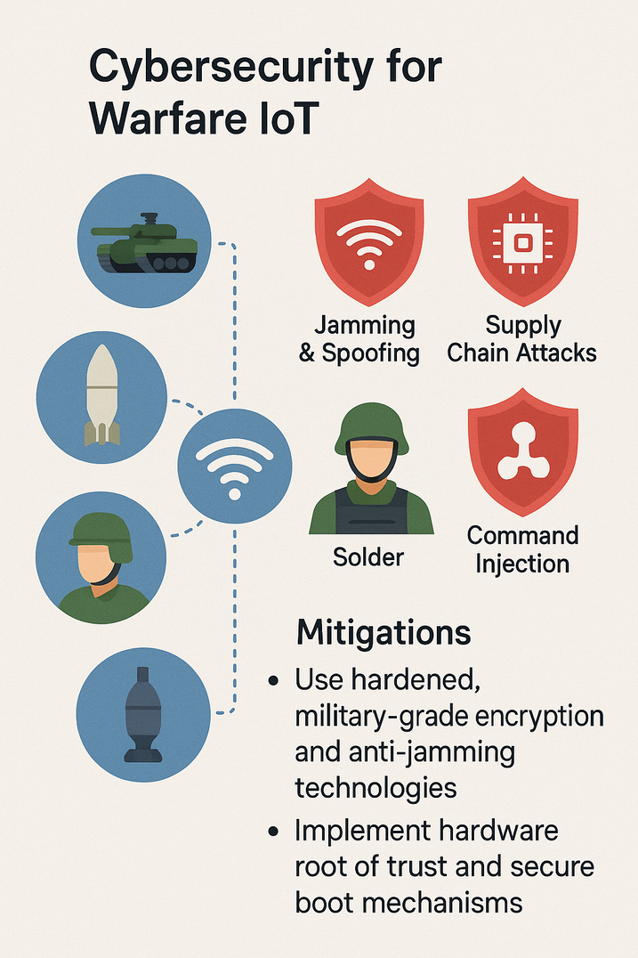
# IOT USED IN WARFARE
Scenario:
Modern battlefields deploy IoT-enabled drones, smart ammunition, autonomous tanks, soldier wearables, and remote surveillance systems.
8

Slide 9
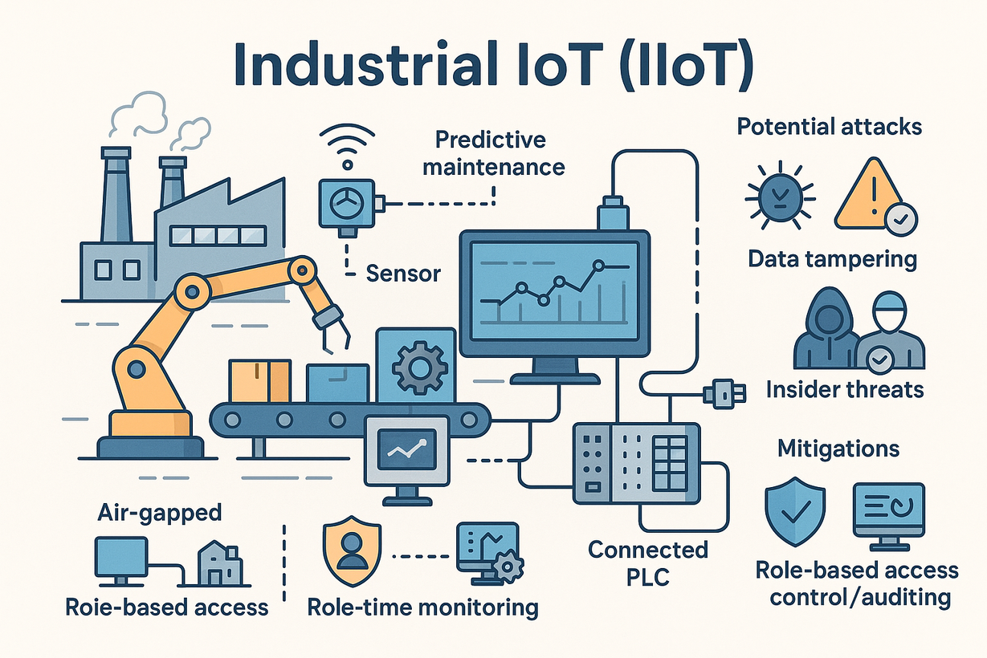
# IOT USED IN INDUSTRIY
Scenario:
A factory uses IoT for robotic automation, predictive maintenance sensors, SCADA systems, and connected PLCs (Programmable Logic Controllers).
9

Slide 10
OWASP TOP 10
(IOT SECURITY)
10

Slide 11

OWASP TOP 10 (IOT)
A project designed to help manufacturers, developers, and consumers better understand the security issues associated with IoT and to enable users to make better security decisions when building, deploying, or assessing IoT technologies. ~ OWASP
11

Slide 12


OWASP TOP 10 (IOT)
Weak, Guessable, or Hardcoded Passwords
Default or hardcoded passwords allow easy access.
Weak and Guessable Passwords are easy to brute.
2. Insecure Network Services
Exposed services can be remotely exploited.
Insecure endpoint and API are a threat.
12

Slide 13


OWASP TOP 10 (IOT)
3. Insecure Ecosystem Interfaces
Weak API/mobile/cloud interfaces can expose devices.
Poor authentication mechanisms can be dangerous.
4. Lack of Secure Update Mechanism
Insecure or missing firmware updates or patches.
Updates transmitted over insecure protocols (HTTP)
13

Slide 14
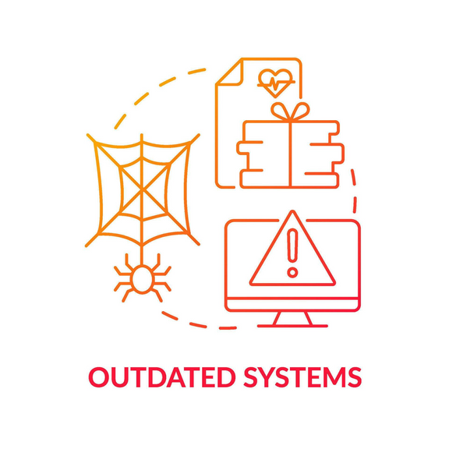

OWASP TOP 10 (IOT)
5. Use of Insecure or Outdated Components
Outdated libraries or components can be exploited.
Unpatched dependencies increase security risks.
6. Insufficient Privacy Protection
Personal or Sensitive data exposure or misuse.
Weak data handling may lead to privacy violations.
14

Slide 15


OWASP TOP 10 (IOT)
7. Insecure Data Transfer and Storage
Data not encrypted in transit or at rest.
Weak protocols can expose sensitive information.
8. Lack of Device Management
Poor and dis-organized asset or update management.
No centralized control over devices or policies.
15

Slide 16


OWASP TOP 10 (IOT)
9. Insecure Default Settings
Devices shipped with weak and insecure defaults.
Default credentials/settings often go unchanged.
10. Lack of Physical Hardening
Easy to tamper with the hardware/device
No protection against physical access or theft.
16

Slide 17
IOT PENTESTING METHODOLOGY
17

Slide 18
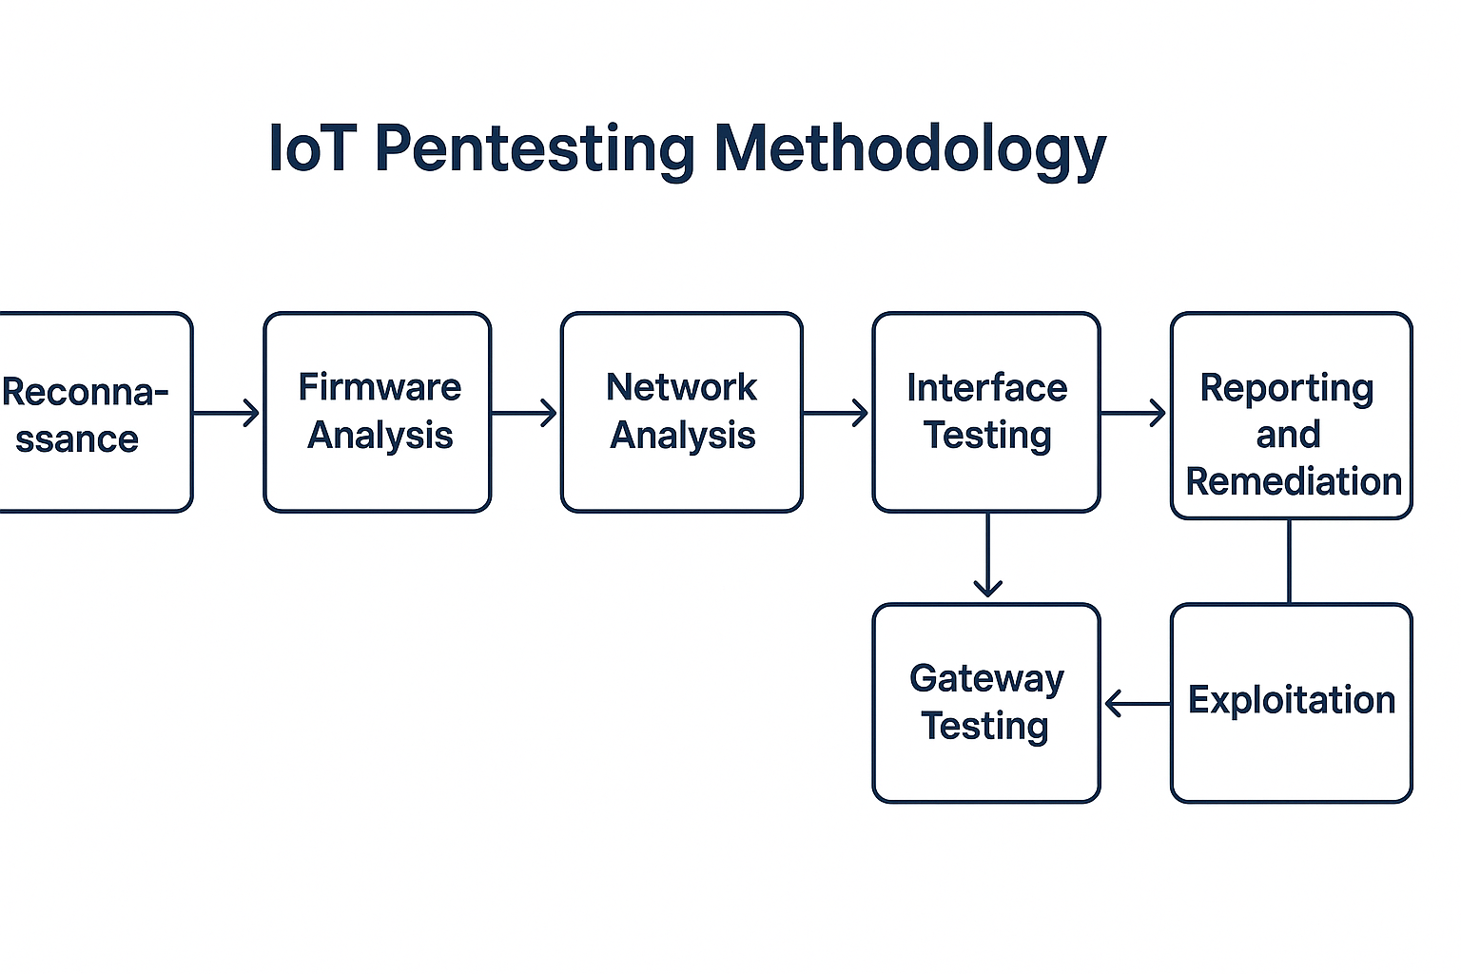
18

Slide 19


# RECONNAISSANCE
Gather information about the IoT system, including device types, communication protocols (e.g., MQTT, CoAP, or HTTP), and associated interfaces like mobile apps or APIs.
Tools like Wireshark can be used to analyze network traffic, and techniques such as scanning for open ports (e.g., with Nmap) help map the system’s architecture.
19

Slide 20

# FIRMWARE ANALYSIS
Extract and analyze the firmware from IoT devices.
Static Analysis: Use tools like Binwalk or Ghidra to inspect the firmware for hardcoded credentials, insecure configurations, or cryptographic flaws.
Dynamic Analysis: Emulate the firmware using tools like QEMU to observe runtime behavior, identify vulnerabilities, or detect malware.
20

Slide 21

# NETWORK ANALYSIS
Examine communication between devices, gateways, and cloud systems.
Identify weaknesses like unencrypted data transmission, weak protocols (e.g., HTTP instead of HTTPS), or default credentials in use.
Simulate attacks like Man-in-the-Middle (MITM) or DoS to test the resilience of the system’s communication layer.
21

Slide 22

# INTERFACE TESTING
Evaluate user-facing components like web dashboards, mobile apps, or APIs for vulnerabilities.
Test for weak authentication mechanisms, session management flaws, or injection vulnerabilities (e.g., SQL injection, XSS).
Use tools like Burp Suite to test APIs and web interfaces for exploitable issues.
22

Slide 23

# GATEWAY TESTING
Analyze gateways for protocol exploits, weak encryption, or improper access control.
Test edge computing processes for vulnerabilities that attackers could exploit to compromise local processing.
Simulate attacks on protocol translations (e.g., MQTT or CoAP) to check for unauthorized access or data leakage.
23

Slide 24

# EXPLOITATION
Attempt to exploit identified vulnerabilities in devices, communication, interfaces, or cloud services.
Examples include gaining shell access on a device, bypassing authentication mechanisms, or injecting malicious payloads into APIs.
Tools like Metasploit or custom scripts are often used in this step.
24

Slide 25

# REPORTING AND REMEDIATION
Document all findings, including identified vulnerabilities, exploitation methods, and their potential impact on the system.
Provide recommendations for mitigating risks, such as applying patches, enforcing encryption, or improving authentication practices. Ensure actionable steps for developers and system administrators to fix security gaps.
25

Slide 26
SOME POPULAR IOT ATTACKS
26

Slide 27

MIRAI BOTNET ATTACK (DYN ATTACK)
Distributed Denial-of-Service (DDoS) attack that occurred on October 21, 2016.
Mirai malware scanned the internet for vulnerable IoT devices
Once it found an insecure device, it logged in and infected it, turning it into a bot
The attacker remotely commanded the botnet to flood Dyn’s DNS servers with massive amounts of junk traffic
By targeting Dyn (a DNS provider), the attack had a cascading effect, taking down multiple major websites at once
27

Slide 28
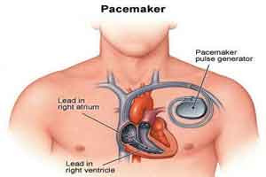
THE HACKABLE CARDIAC DEVICES
St. Jude’s devices used a home transmitter to remotely send patients data to doctor.
This transmitter communicated via RF signals and Wi-Fi, but had no encryption or authentication.
Hackers could intercept wireless signals between the implant and transmitter.
Battery drain attacks, Malicious Shock Command, Data Theft.
28

Slide 29
THE OWLET WIFI BABY HEART MONITOR VULNS
Popular wearable device that tracks infants' heart rate and oxygen levels
The monitor transmitted sensitive baby health data (heart rate, oxygen levels) in plaintext over WiFi
If the sensor sock came off (e.g., baby kicked it loose), the monitor did not automatically restart
The device lacked a secure update mechanism, meaning security flaws could not be patched easily.
MITM attacks, DOS attacks, WIFI jamming.
29

Slide 30
TOOLS USED IN IOT SECURITY
30

Slide 31

ATTIFY OS
Opensoure Linux-based penetration testing distribution specifically designed for IoT and embedded device security assessments.
Contains pre-installed iot security tools
Support for Hardware Interface like JTAG, UART etc
Contains automated firmware extraction scripts.
31

Slide 32

FIRMADYNE
Firmadyne is an open-source framework designed for automated emulation and vulnerability analysis of IoT firmware
Emulate firmware in a virtualized custom based QEMU environment.
Detect vulnerabilities (e.g., backdoors, hardcoded credentials).
Test exploits without needing physical hardware.
D-Link firmware backdoor (CVE-2019-16920) was discovered using Firmadyne.
Found hardcoded admin credentials.
32

Slide 33

EMBEDDED ANALYZER
EMBA is an open-source firmware security analyzer specifically designed for IoT and embedded devices.
It automates firmware extraction, static vulnerability scanning, dynamic emulation-based analysis and compliance checking
Developed as a successor to tools like Firmadyne
33

Slide 34
THANK YOU
34

Slide 35
35

